Slide 1



Name | ID
Aleef Ahmed | 1620964030
Md shafiqul islam | 1620184630
Alif Rahman Khan | 1620083030
Dewan Tangil | 1620151030
Md Sharif Hossain | 1712336642

Slide 2
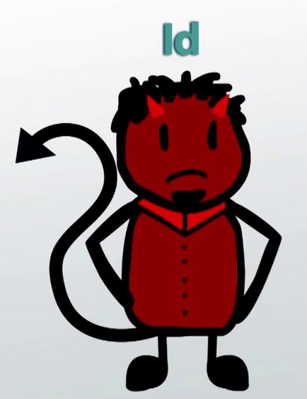
ID
Characteristics:
Basic part of the personality
Represents the most animalistic urges o human being
Immediate satisfaction of their want sand needs
People can be anxious or angry if the wants and needs are not met

Slide 3
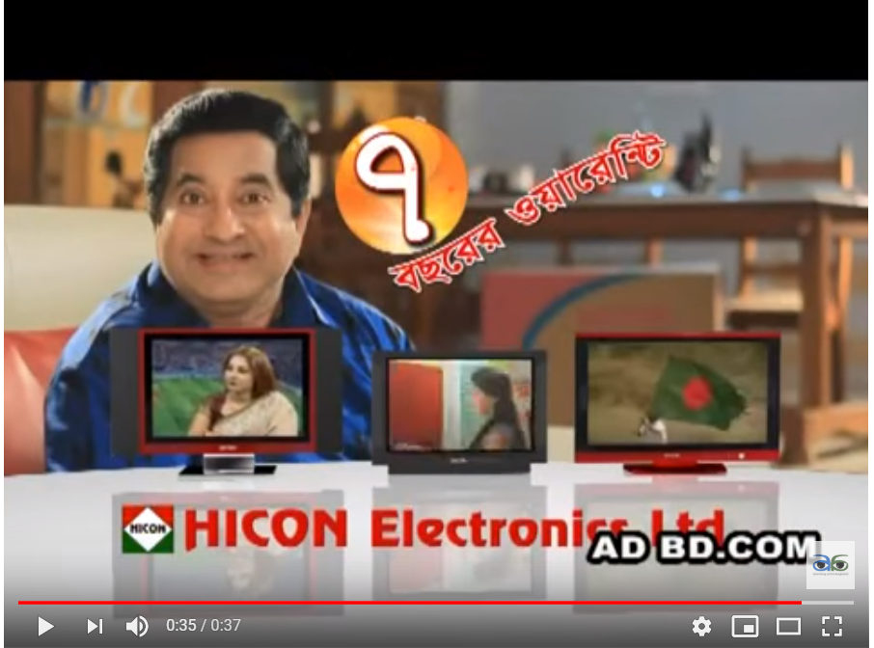
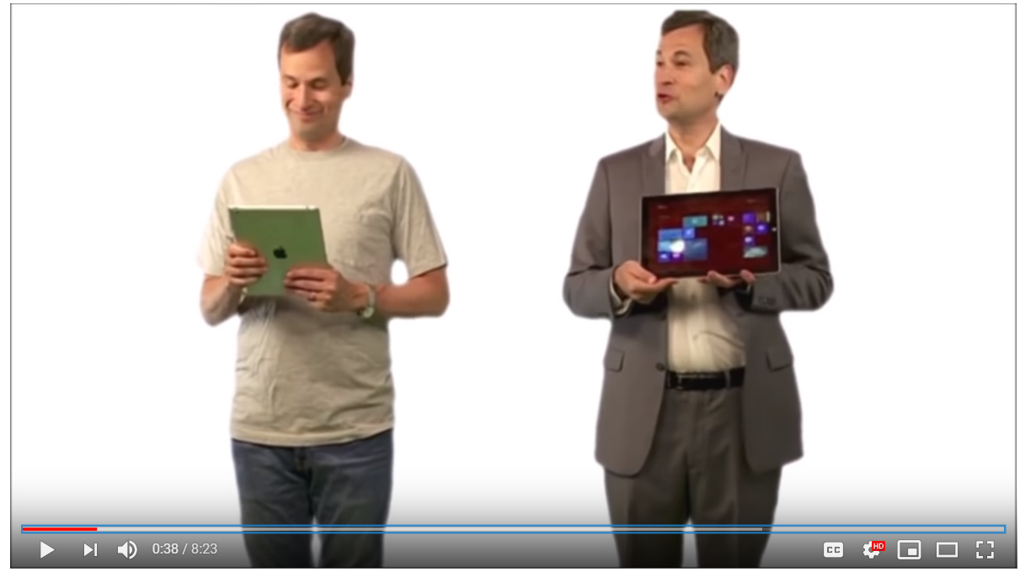
Local ad (ID) https://www.youtube.com/watch?v=_FVV9du6hFU
INTERNATIONAL EXAMPLE https://www.youtube.com/watch?v=t7s4gVOO4ys&t=211s

Slide 4

Non marketing example
People stuck in the traffic want to move their own car before anyone else are having id personality. Because they are only concern about their own cars and opportunities.

Slide 5

Super ego
Characteristics :
Expression of an individual towards society
Based on morals and judgments between right or wrong
Decision making is based on moral values

Slide 6
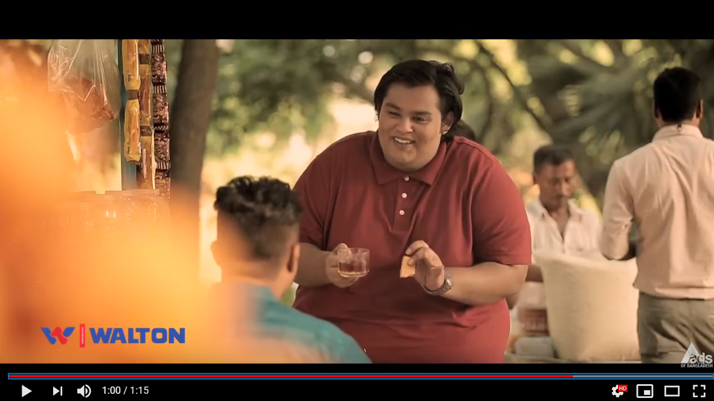
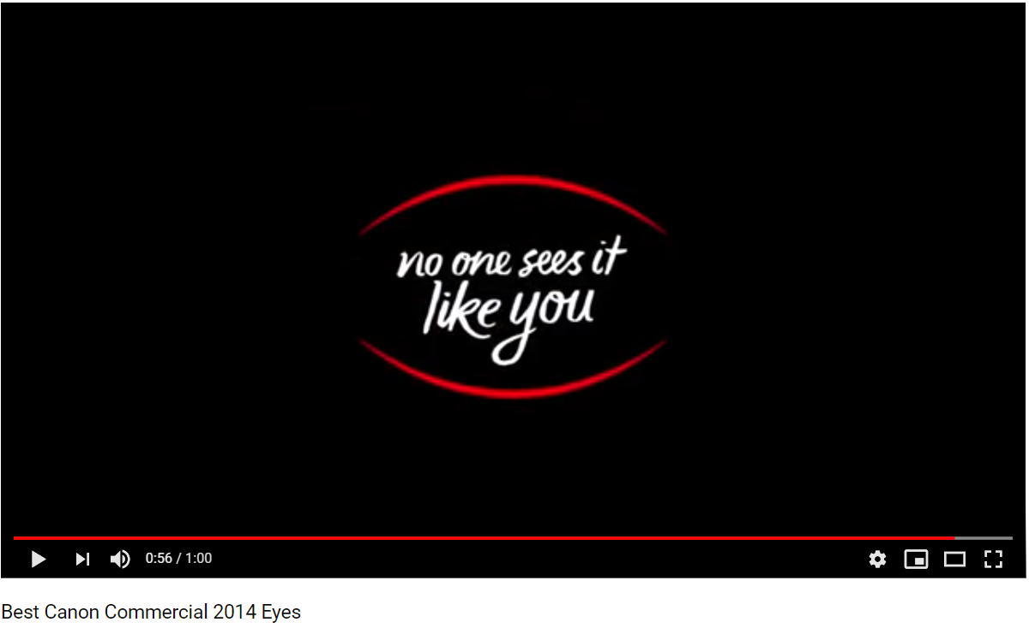
Local example https://www.youtube.com/watch?v=42hEaUu7DKI
International example https://www.youtube.com/watch?v=uRD1se7ZQjY

Slide 7

Non marketing example
Alam knew that throwing unused electrical battery in the open place is harmful for the environment so he decided to recycle it into something useful.

Slide 8
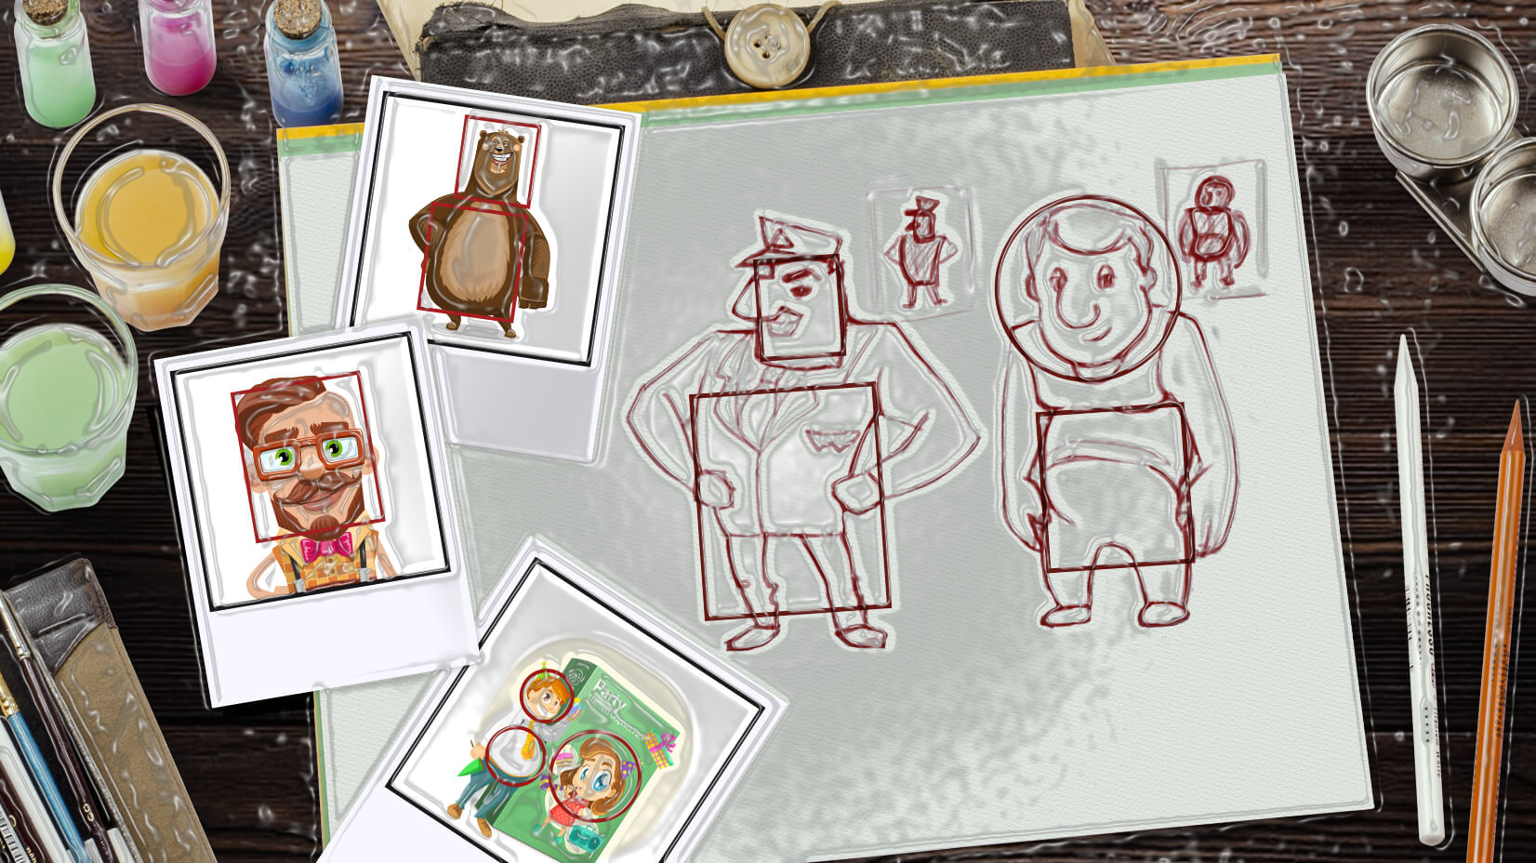
Compliant Personality (Neo-Freudian Theory)
A person having compliant personality has a tendency to be liked by others, move towards them. The compliant personality has a dominant need and desire to be loved, wanted and appreciated. This type of personality work to make others pleased and satisfied. The care and are cared.

Slide 9
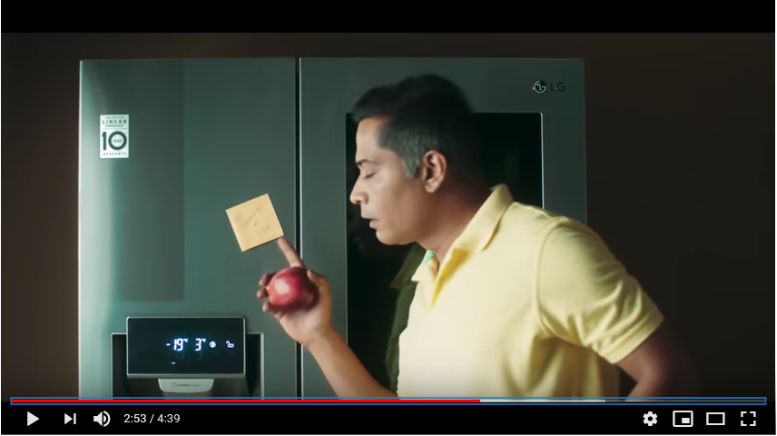
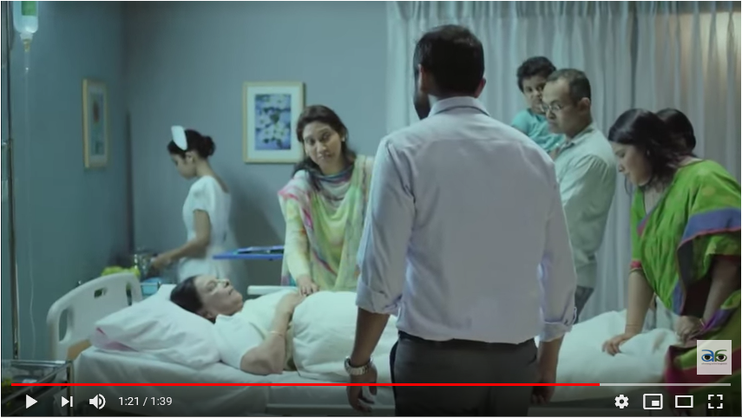
International Example: LG Innovation Story - Brand Film 21 Years Celebrations
National Example: Okapia Maa TVC Mayer Jonne Valobasa
YouTube link: https://www.youtube.com/watch?v=O8jHf6cwWB0
YouTube link: https://www.youtube.com/watch?v=foIeJlfAfWE

Slide 10

Non-Marketing Example: My mother hardly keeps special schedules in weekends. Because she knows I would go home in weekends and she wants to spend as much as her time for me and with me.

Slide 11
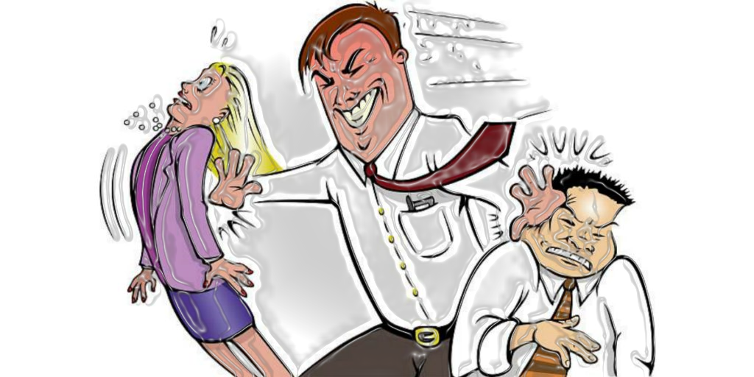
Aggressive Personality
The person having aggressive personality move against others, they desire to win and excel admiration. Also their interests include being the boss, moving to positions of leadership, assuming command, undertaking huge responsibilities, wielding power, competing with confidence and never backing away from a fight.

Slide 12
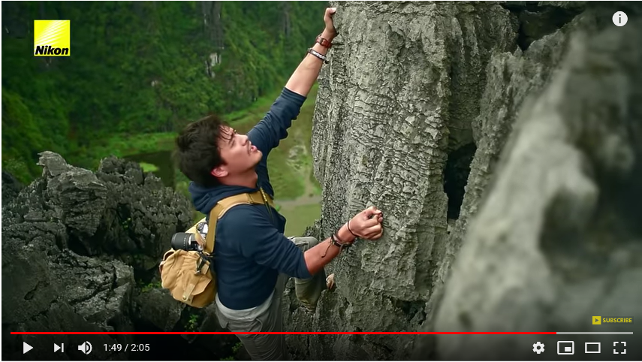
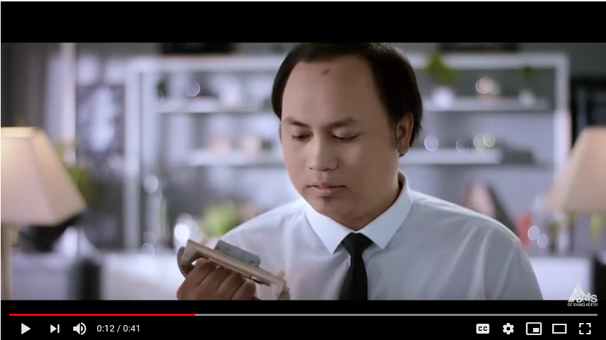
International Example: Nikon D7200: The Road Less Travelled
National Example: Esquire Electronics (General Air Conditioner)
YouTube link: https://www.youtube.com/watch?v=P4K_8QQaprI
YouTube link: https://www.youtube.com/watch?v=zsOSqBR3_tI

Slide 13
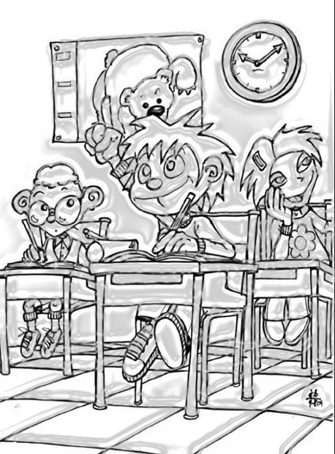
Non-Marketing Example: My nephew prefers going early to the school. Because if he goes early, he can sit in the first bench and can be focused to the teachers.

Slide 14
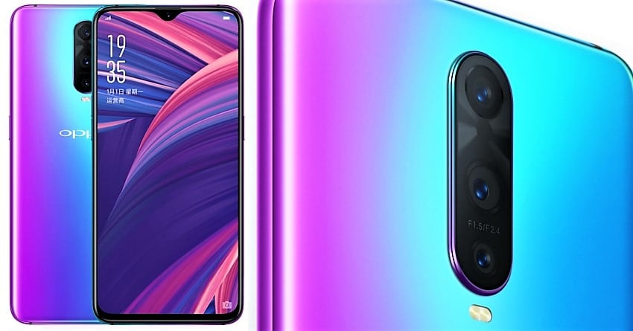
Visualizer
Visualizer consumer are the consumer who prefer more high graphics or technical advertisement than information giver advertisement. These types of consumer depend on that of visualize advertisement to buy any product.

Slide 15
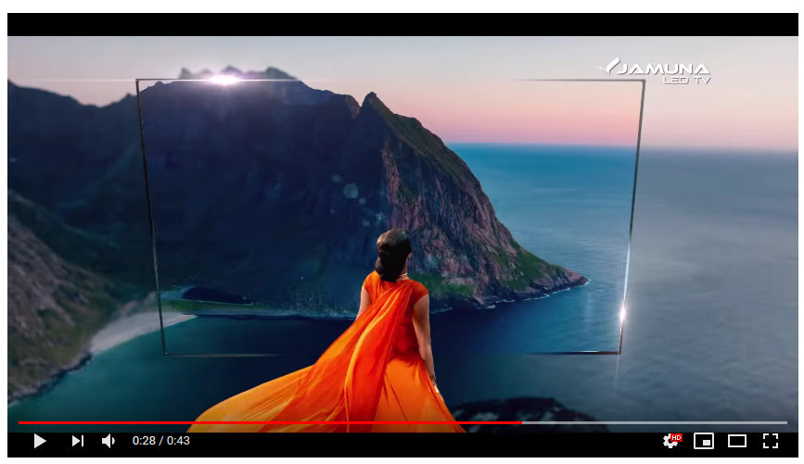
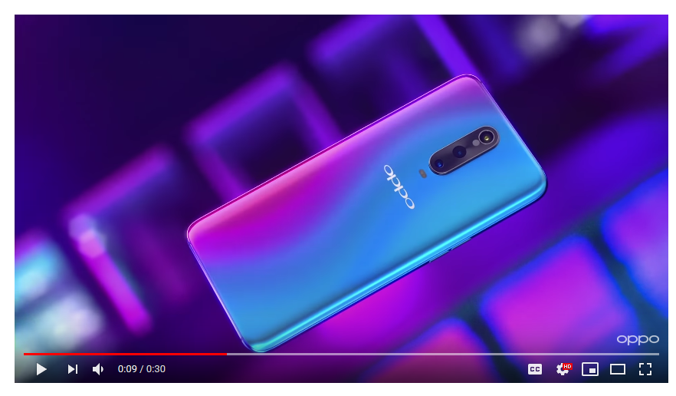
National Example:
International example
This the Jamuna LED TV advertisement of Bangladesh.
Video Link: https://youtu.be/kou6hnXdRNg?t=28
This an international advertisement of OPPO Mobile.
Video link: https://youtu.be/_YxEGG4cePg?t=9

Slide 16

Non-Marketing Example: One of my friend bought OnePlus 7pro mobile. The price of that mobile 70 thousand taka. Later I leant that he was very much interested by that company’s TVC. That’s why he bought that phone. OnePlus Company made a very high graphics TVC to attract their customer.

Slide 17
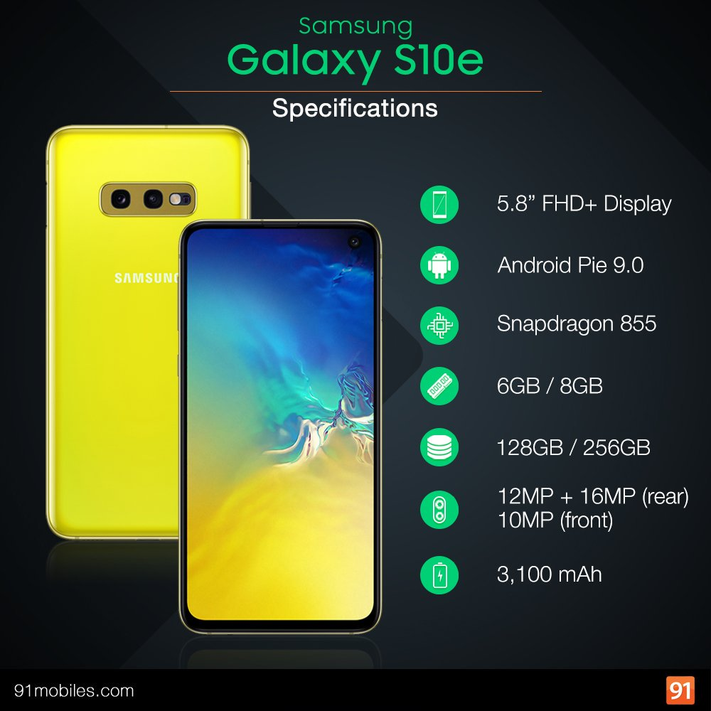
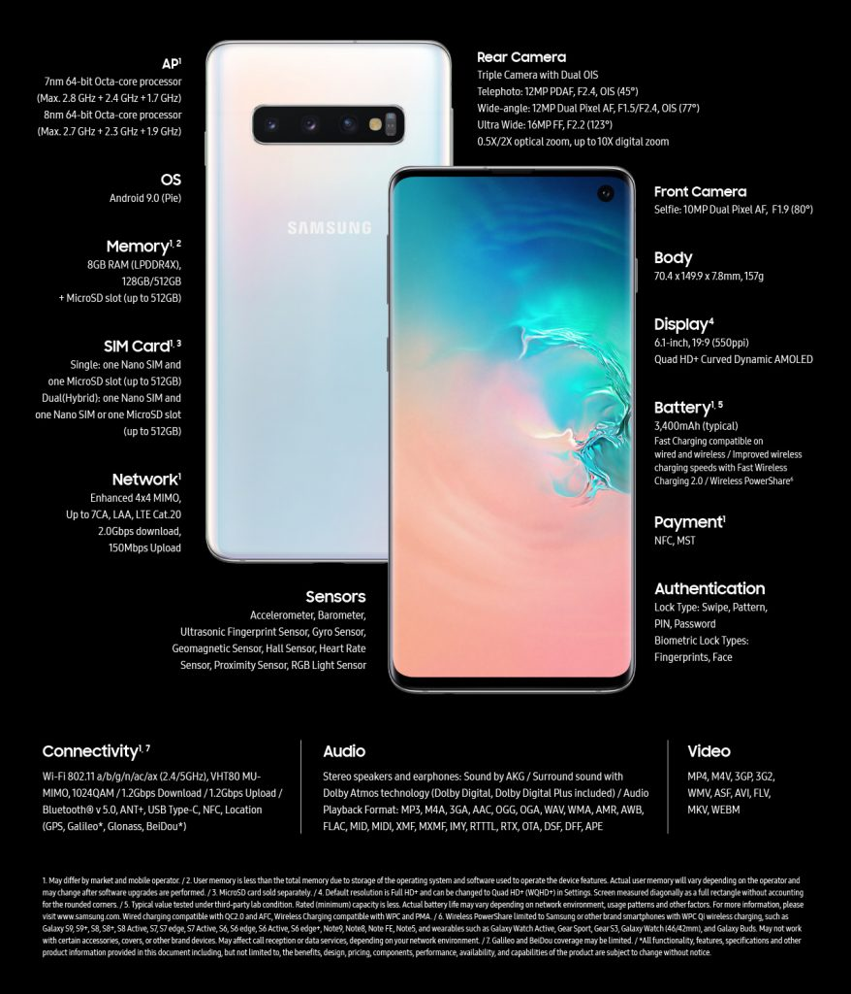
Verbalizer
Verbalizer consumers more focus on that type of advertisement where plenty of information are given to the advertisement.

Slide 18
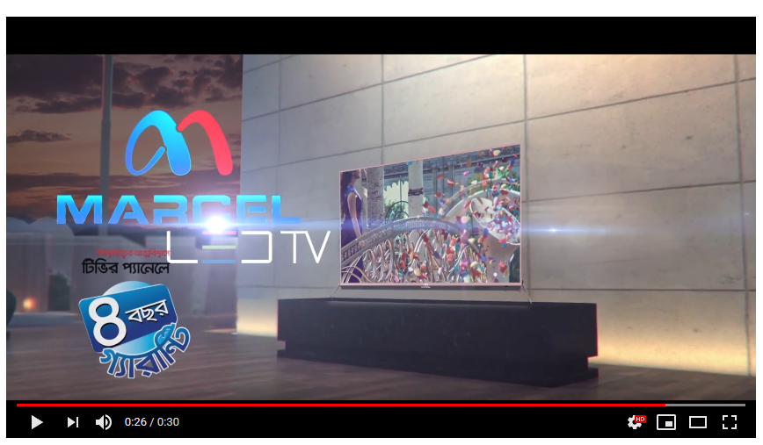
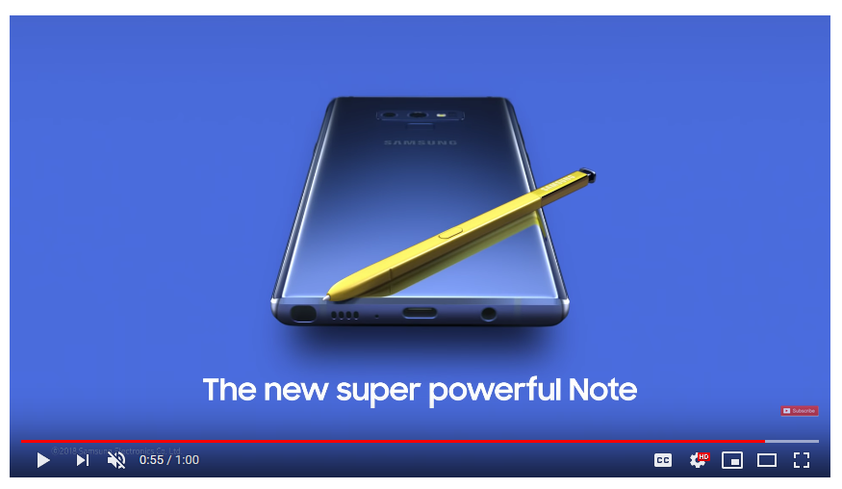
National example
International advertisement
This TVC was given by the Marcel Company for their LED TV
This TVC was made by the Samsung Company for their new launched phone Samsung galaxy note9.
Video link: https://youtu.be/DFQcsGtKRxE?t=26
Video link: https://youtu.be/QFFlkm2FzOM?t=55

Slide 19
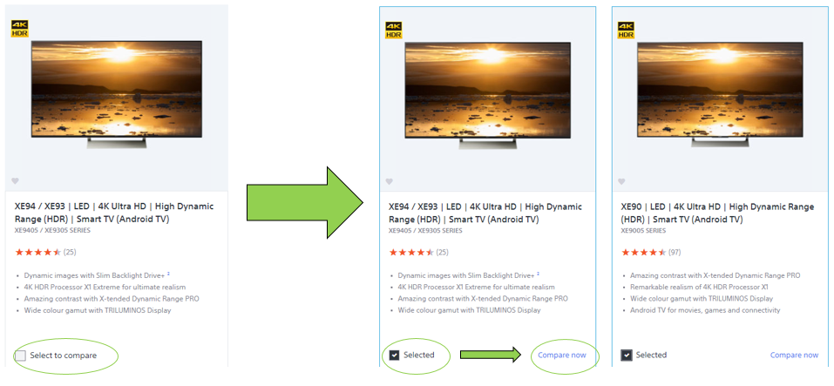
Non-marketing example: When I bought LED TV for my family, I saw a TVC of Sony TV. On that TVC many information was given, and I gather all that information before buying that TV.

Slide 20
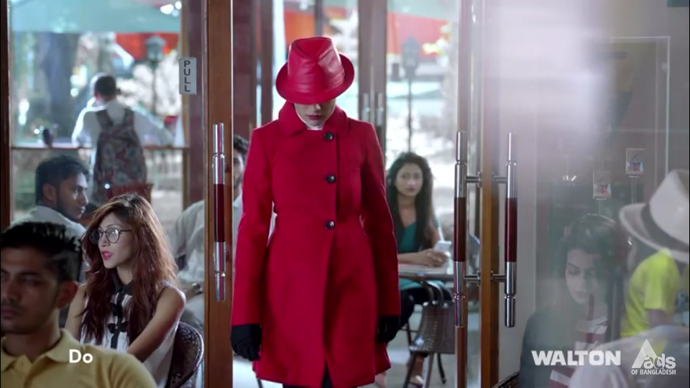
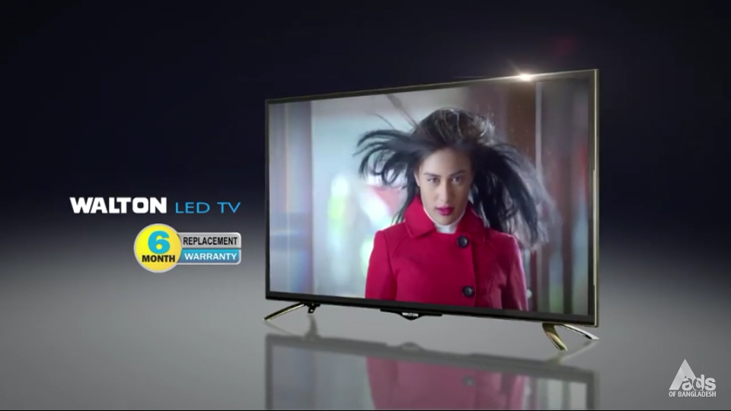
Need for Uniqueness: Consumers who avoid appearing to conform to expectations or standards of others. In the simplest way we can say that peoples who wanted to look unique unlike other peoples.
Local Example: Walton LED TV

Slide 21
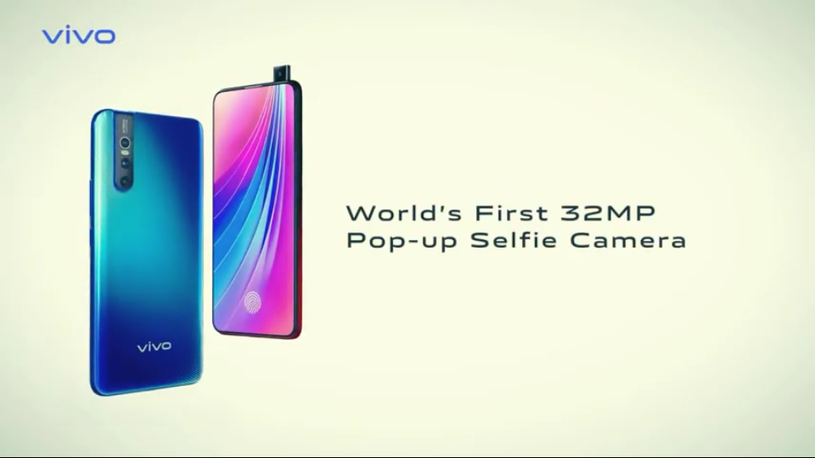
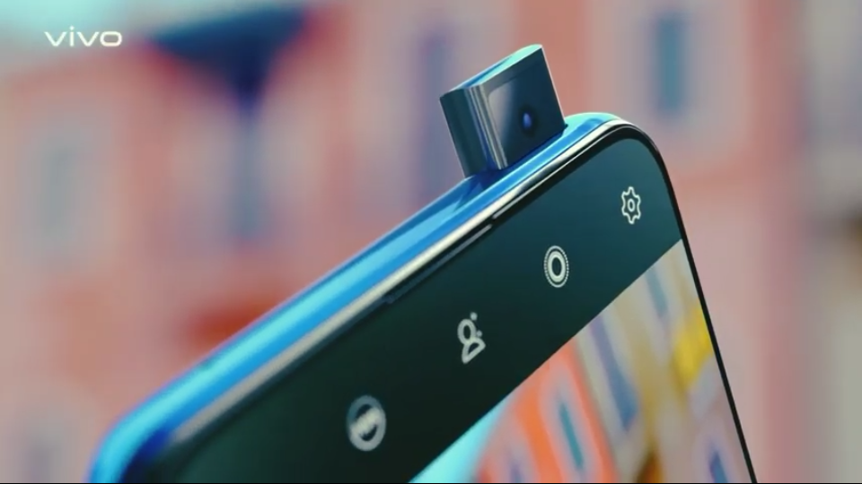

Need for Uniqueness:
International Example: Vivo V15

Slide 22
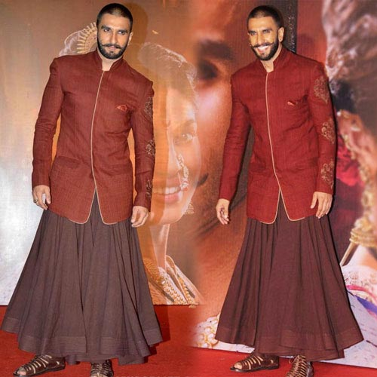
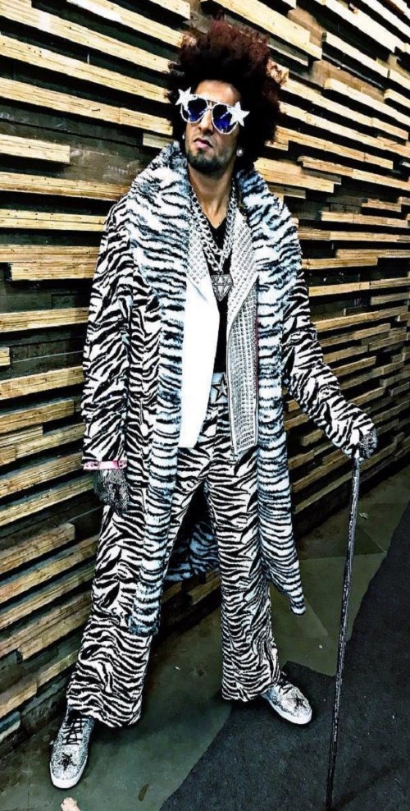
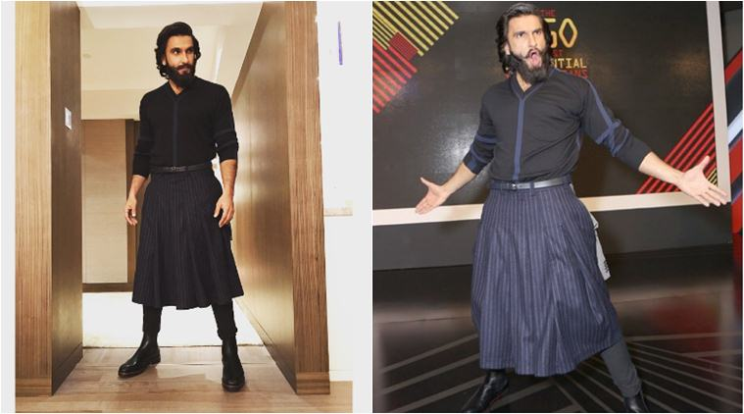
Need for Uniqueness:
Non-marketing example: Ranveer Singh (Celebrity)

Slide 23
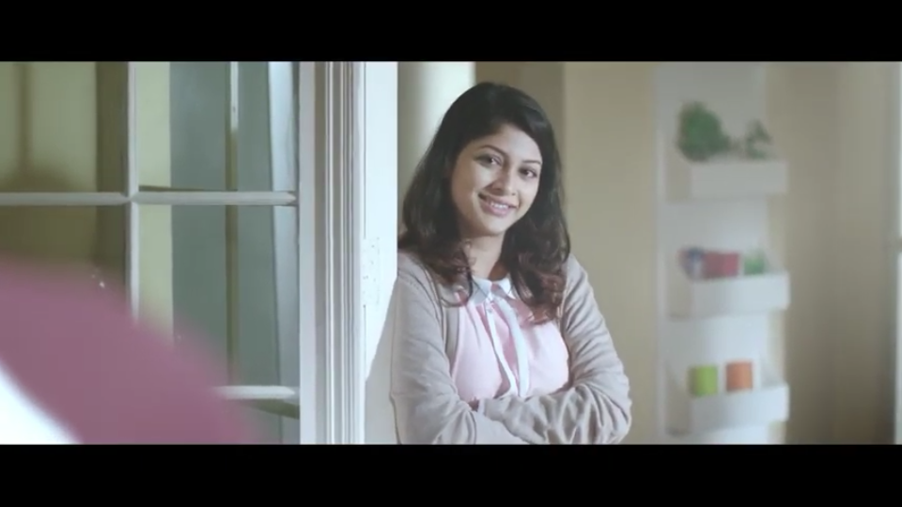
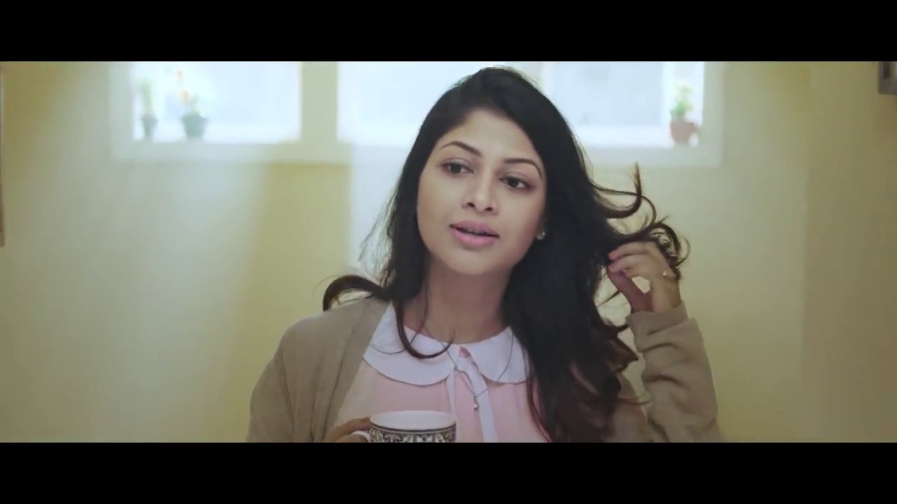
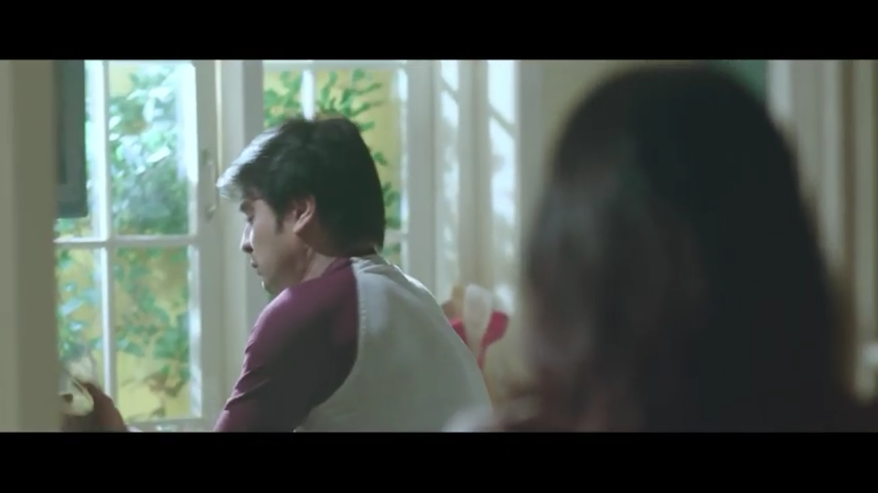
Dogmatism: a personality trait that reflects the degree of rigidity a person displays towards the unfamiliar and toward information that is contrary to his or her own established beliefs. Dogmatism also represents the close-minded people’s personality & their thoughts.
Local example: Vigo Electronics

Slide 24
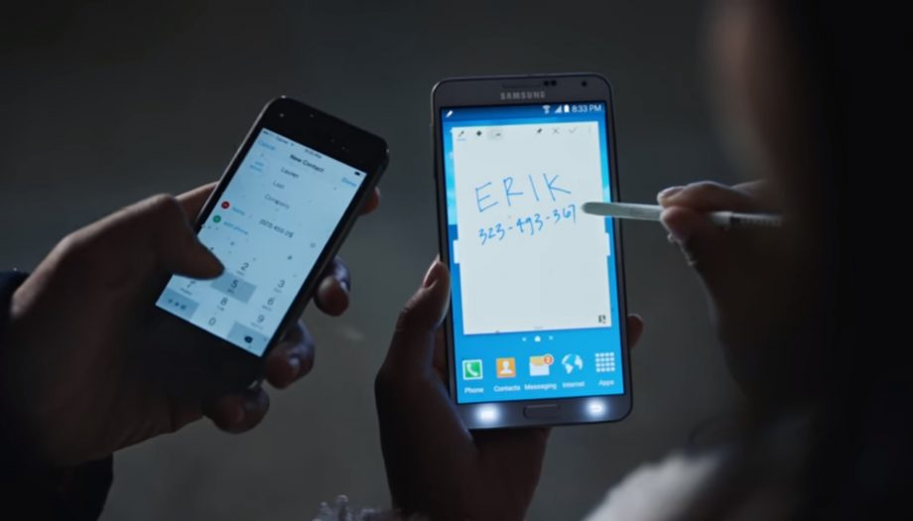
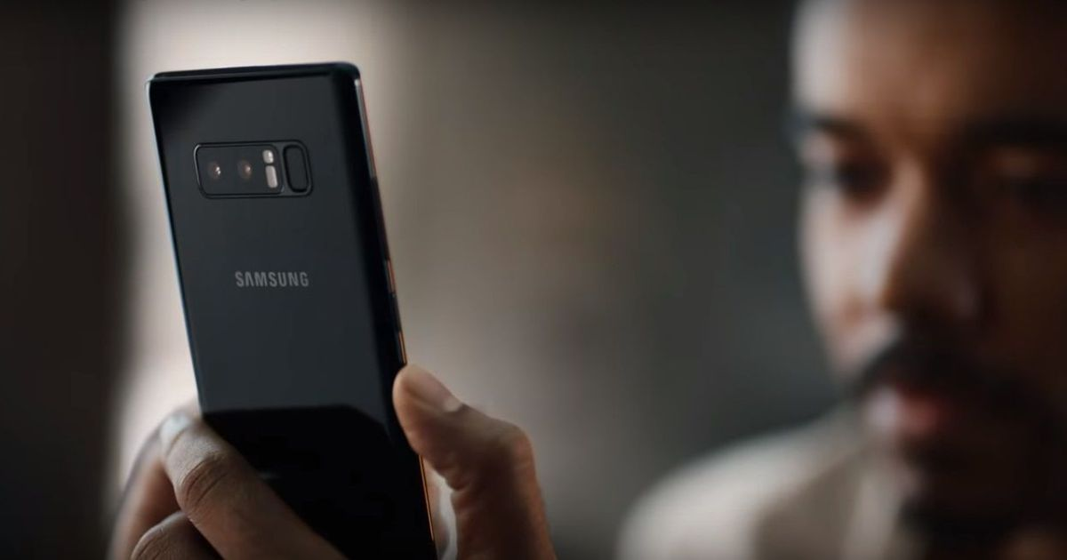
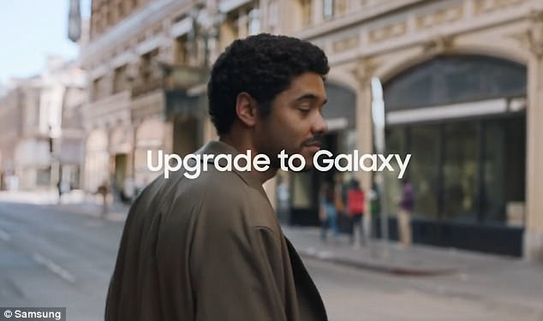
International Example:
Samsung Galaxy note 8 phone’s TVC

Slide 25
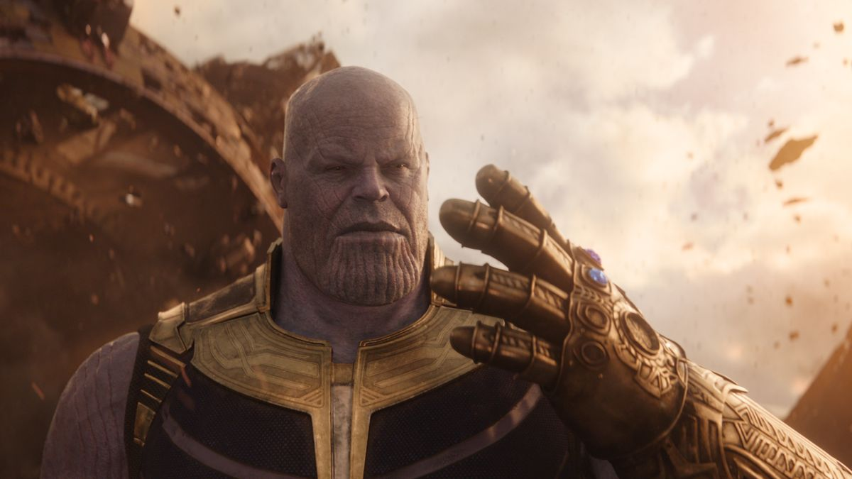
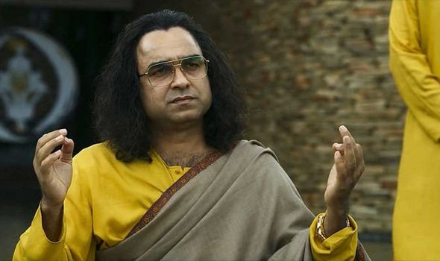
Non-marketing example:
THANOS & GURUJI

Slide 26
Need for Cognition
Need for cognition is a personality trait that describes an individual's craving for enjoyment of thinking. Higher need for cognition indicates a greater enjoyment for critical thinking. This kind of people looks for more information about the product.

Slide 27
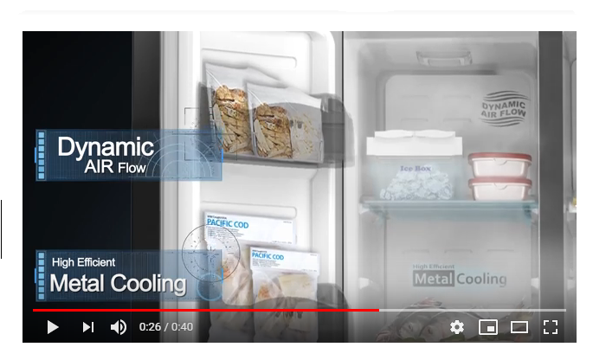
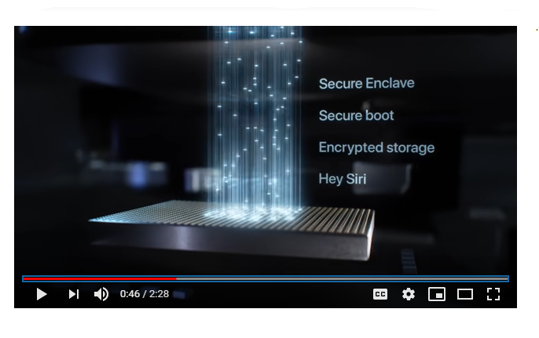
Local Example
International Example
Local Example Video Link : https://www.youtube.com/watch?v=FTuh1gsMjhk
International Example Video Link: https://www.youtube.com/watch?v=hs1HoLs4SD0&feature=youtu.be&fbclid=IwAR25adj8-vDlH4ExgeHm8Rde62ccntFe4Bcm1aunPzq_PHIgFO5DWXUvXJc

Slide 28
Need for Cognition (Non-Marketing Example)
My friend is very much interested about new electronic technology. When new technology comes in the market, he willingly collects the whole information of that individual product and thinking of it. After completing his whole analysis than he can take his decision to buy that product or not.

Slide 29
Benefit Segmentation
Benefit segmentation requires marketers to divide the market based on the perceived value, benefit or advantage of the product or service. The market could be segmented based upon quality, performance, customer service, special features and other benefits. Different consumers look for different benefits and the marketer needs to understand each segment and accordingly develop his communication for each group.

Slide 30
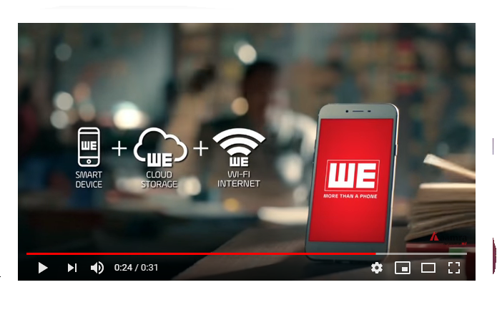
Benefit Segmentation (Local Example)
Local Example Video Link : https://www.youtube.com/watch?v=t-ioDx7f_Hc&fbclid=IwAR2GF1BuhYG7VhoscnB1wwb9BL5IbsMC0Funqabpy8A10wfrFawtnnSjLiQ

Slide 31
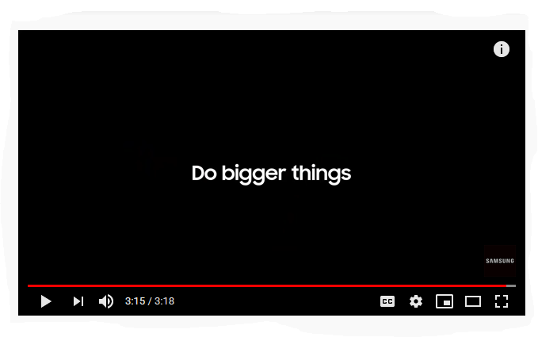
Benefit Segmentation (International Example)
International Example Video Link : https://www.youtube.com/watch?v=kHcEiRWaJuo

Slide 32
Benefit Segmentation (Non-Marketing Example)
I am doing a job for 1 year. From the 1st month I have decided that I will buy a high budget Smartphone with my own money. As it is a high involvement product that’s why at every night, I browse the specifications, price & other details related with each & every high budget smartphone. Because by evaluating all of the alternatives, I will be able to buy a best phone in my budget range.

